Slide 1
Consumer GooDS Analysis
Agenda
Problem Statement and Project Overview
ATLIQ Business Model
DATA-SET
10 AD-HOC Requests

Slide 2
ABOUT ATLIQ
ATLIQ Hardwares is a leading hardware company speacializing in PCs, Printers, Mice and computer with a global reach and producers in India and well expanded in other countries too.
PROBLEM STATEMENT
The management noticed that they do not get enough insights to make quick and smart data-informed decisions
ATLIQ Hardware, a leading computer hardware producer faced a critical challenge because of missing crucial insights.
They need quick and data informed decisions to stay compitative in the ever-evolving market.

Slide 3
PROJECT OVERVIEW
In this ATLIQ project, I will be working with a dataset which is related to consumer goods. The main goal of this project is to solve the specific ad hoc requests using MYSQL workbench to get the insights using sql queries.

Slide 4
ATLIQ HARDWARE BUSINESS MODEL
Customer Platforms
Customer
Croma
E-Commerce
Brick and Martar
Best buy
Staples
Flipkart
Croma
Best buy
Amazon
Flipkart

Slide 5
Product Division
PC
N&S
P&A
WiFi Extenders
USB flash drivers
Processor
Mother board
Personal laptop
Gaming laptop
Keyboard
Mouse

Slide 6
Product Segment
accessories
Storage
Notebook
Networking
Peripherals
Desktop

Slide 7
DATA SET
Database gdb023
Tables
Dim-customer
Dim-product
Fact-gross-price
Fact-sales-monthly
Fact-manufacturing-cost
Fact-pre-invoice-deduction

Slide 8
AD-HOC_REQUEST
Check ‘ad-hoc-requests.pdf’ - there are 10 ad hoc requests for which the business needs insights

Slide 9
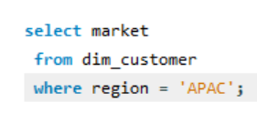
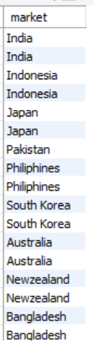
Questions:
1. Provide the list of markets in which customer "AtliqExclusive" operates its business in the APAC region.

Slide 10
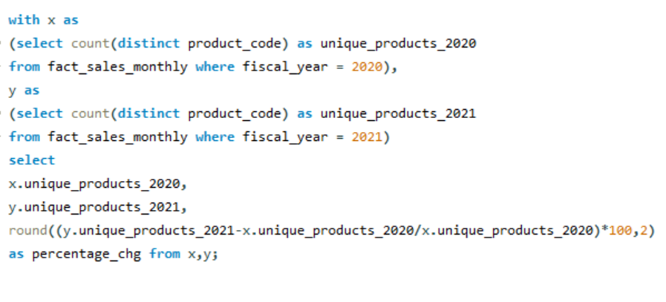
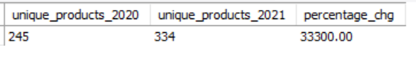
2. What is the percentage of unique product increase in 2021 vs. 2020?
Note:
Fiscal-year 2020 is from sep-2019
To aug-2020
Fiscal-year 2021 is from Sep2020
To Aug-2021

Slide 11
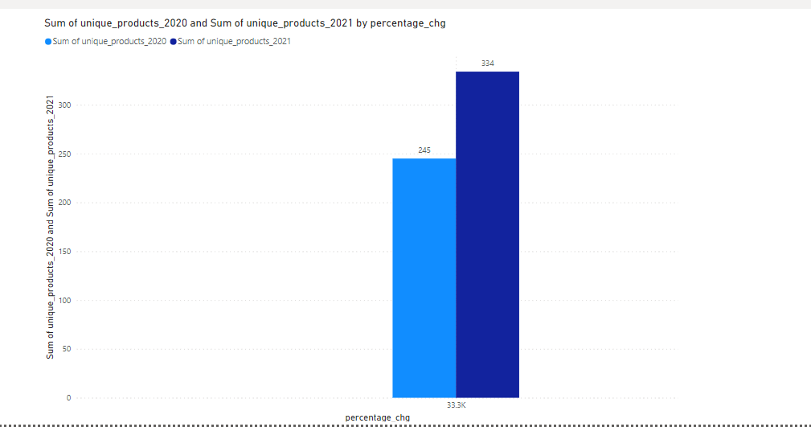
VISUALS-01
Insights
In 2020 unique product count is 245 and
unique product sum in 2021 is 334.
This can help the business persons to know how much the unique products sold over years and it got increased in 2021 so this is a good sign for them to get to know that customers are buying more unique products.
The percentage of unique products sale from 2020 to 2021 increased to 33.3k percentage.

Slide 12
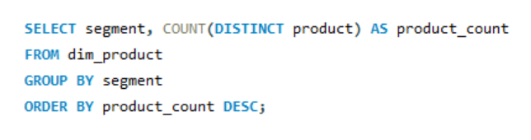
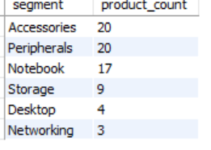
3. Provide a report with all the unique product counts for each segment and sort them in descending order of product counts.

Slide 13
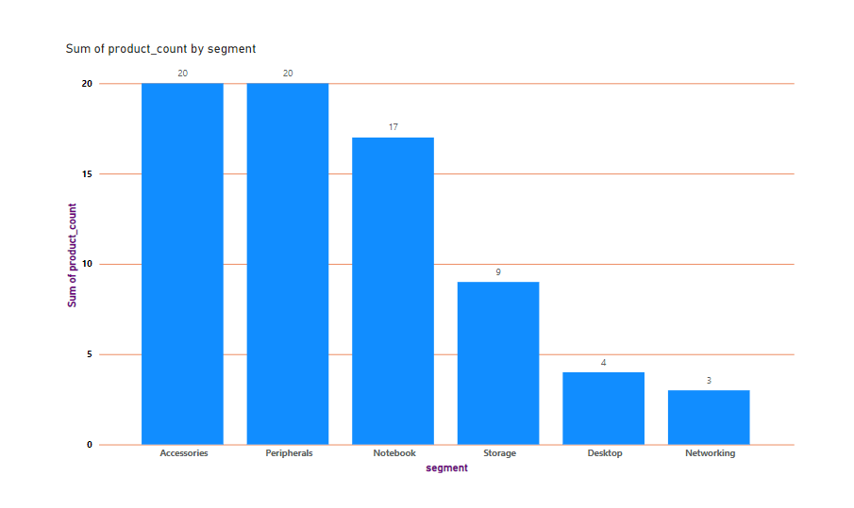
VISUALS-01
Insights
Here in this visual we can see that segment is in x-axis and sum of product count is in y-axis and
Accessories is in first position with more product count of 20 followed by peripherals, Notebook, storage, Desktop, Networking got last place in the sum of product count that is with product count of 3 .

Slide 14
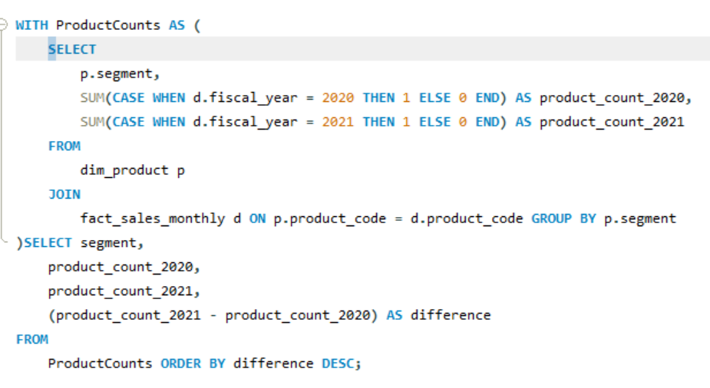
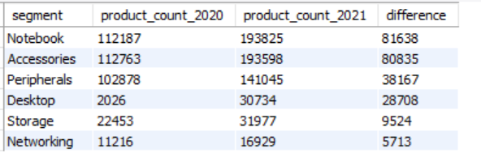
4.Which segment had the most increase in unique products in 2021 vs 2020?

Slide 15
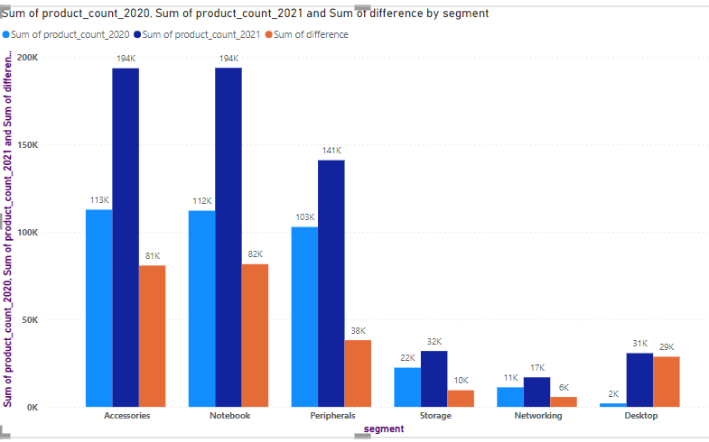
VISUALS-01
Insights
In this we can see that Accessories segment has more product code in 2021
Compared to 2020 we can see the difference as 81k from 2020 to 2021 in Accessories .Notebook is in second position in product count this leads to the compitation among the segments and customers got more choices.

Slide 16
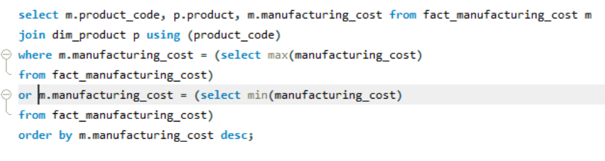
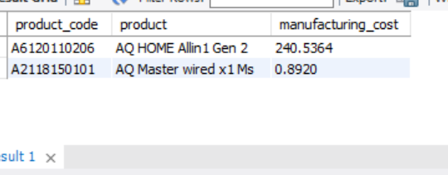
5. Get the products that have the highest and lowest manufacturing costs.

Slide 17
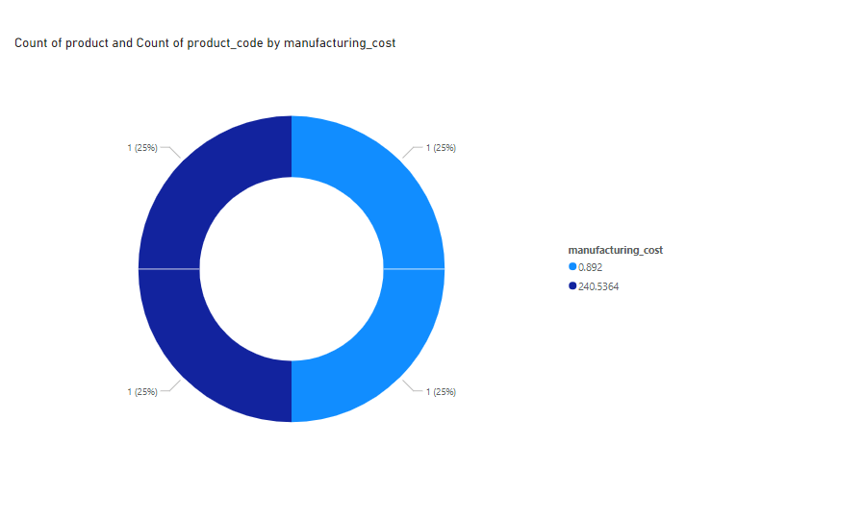
VISUALS-03
Insights
By this we can say that
AQ Home allin 1 gen 2 has more manufacturing cost of 240,5364 and AQ Master wired x1 MS

Slide 18
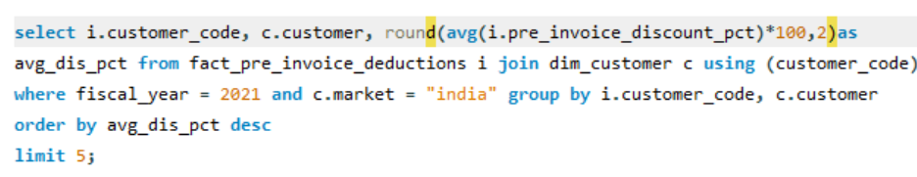
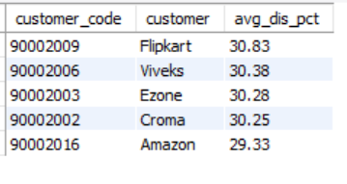
6. Generate a report which contains the top 5 customers who received an average high pre_invoice_discount_pct for the fiscal year 2021 and in the Indian market.

Slide 19
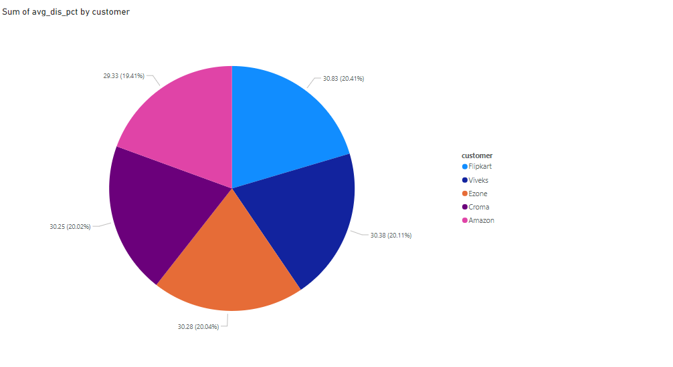
VISUALS-04
Insights
Here we can see that “Flipkart” has the high pre-invoice discount of 20.41%
“Amazon” has the less pre-invoice discount with only 19.41%.
These insights can be valuable for adjusting the invoice discounts and understanding customer preferences.

Slide 20
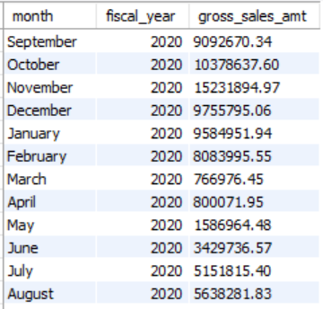
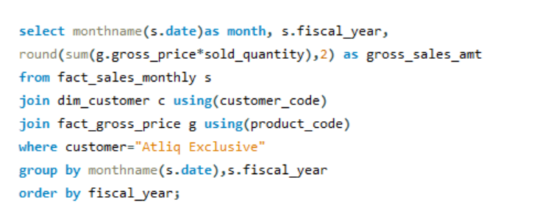
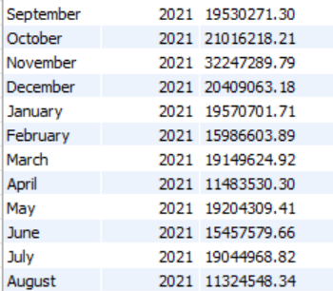
7. Get the complete report of the Gross sales amount for the customer “Atliq-Exclusive” for each month .

Slide 21
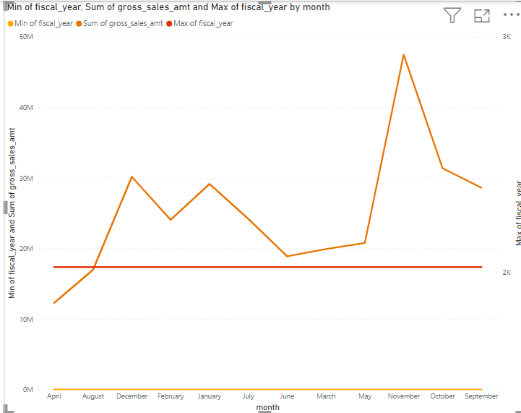
VISUALS-05
Insights
There are 2 fiscal years namely 2020 and 2021, Nov 2021 has highest gross sales amount.
Fiscal year 2021 started with lower sales in Sep but had significant peak in November.
March and April of fiscal year 2020 has low sales.
From this we can guide strategic decisions such as focusing marketing efforts and inventory planning around peak sales months and addressing potential challenges during lower sales months.

Slide 22
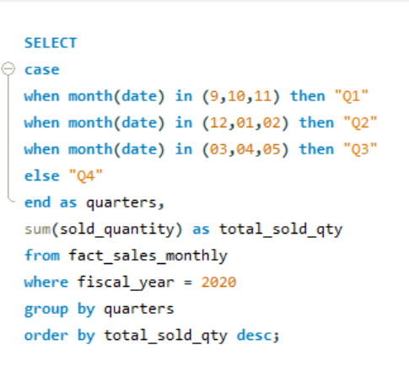
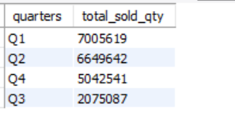
8. In which quarter of 2020, got the maximum total_sold_quantity?

Slide 23
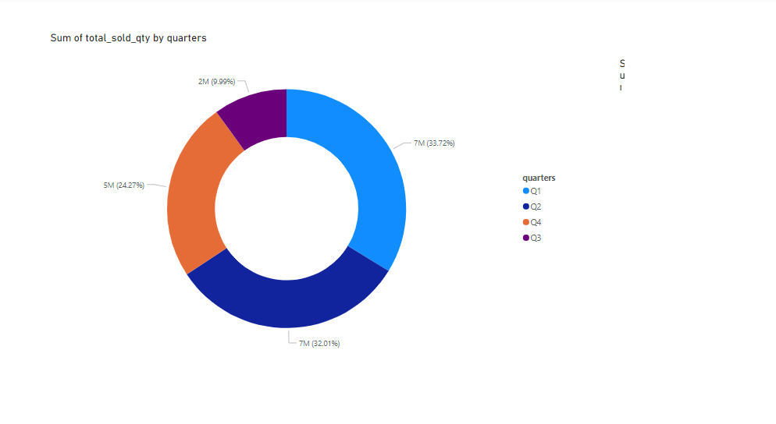
VISUALS-06
Insights
Quarter 1 has high total sold quantity with 7 million and
Quarter 2 has second highest
With 7 million but in percentage we can see that quarter 2 is lagging behind quarter one with 1.72%
Quarter 3 is the weakest amongst them with only 2 million.
These insights are helpful for planning inventory and marketing strategies to alien with seasonal demand.
Note:
Q1=Sep, Oct, Nov
Q2=Dec, Jan, Feb
Q3=Mar, Apr, May
Q4=Jun, Jul, Aug

Slide 24
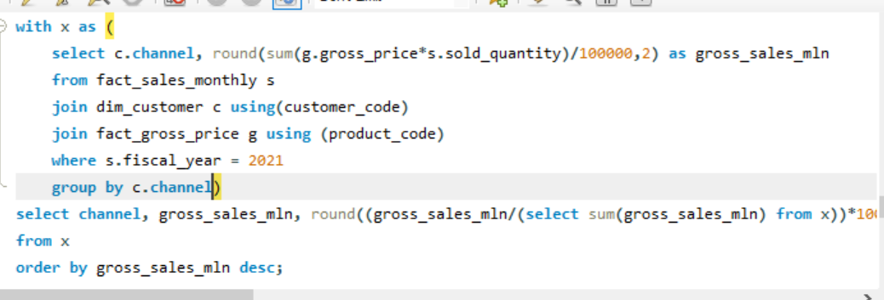
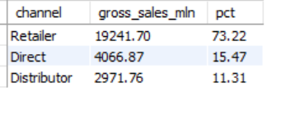
9. Which channel helped to bring more gross sales in the fiscal year 2021 and the percentage of contribution?

Slide 25
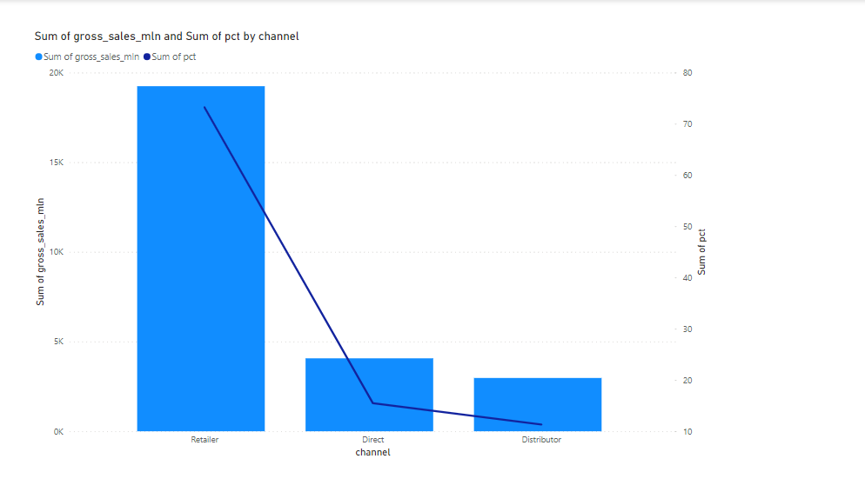
VISUALS-07
Insights
“Retailer” channel has majority of sales almost nearing to 20k and 75pct and followed by direct with sales of 4k and 25 pct and weak channel is distributer with only 3k and 20 pct

Slide 26
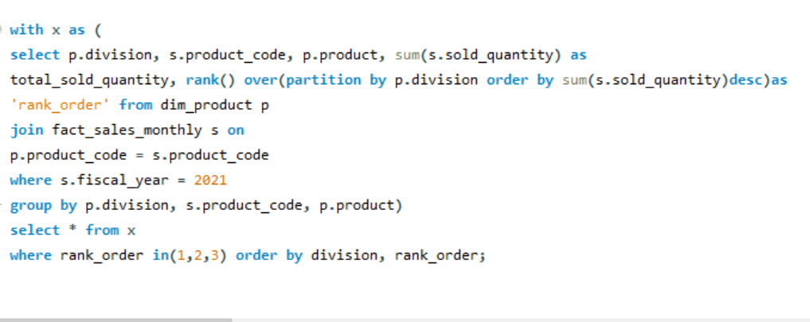
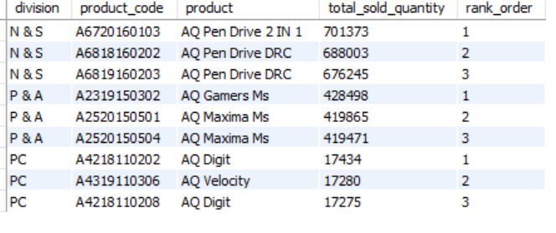
10. Get the Top 3 products in each division that have a high total_sold_quantity in the fiscal_year 2021?

Slide 27
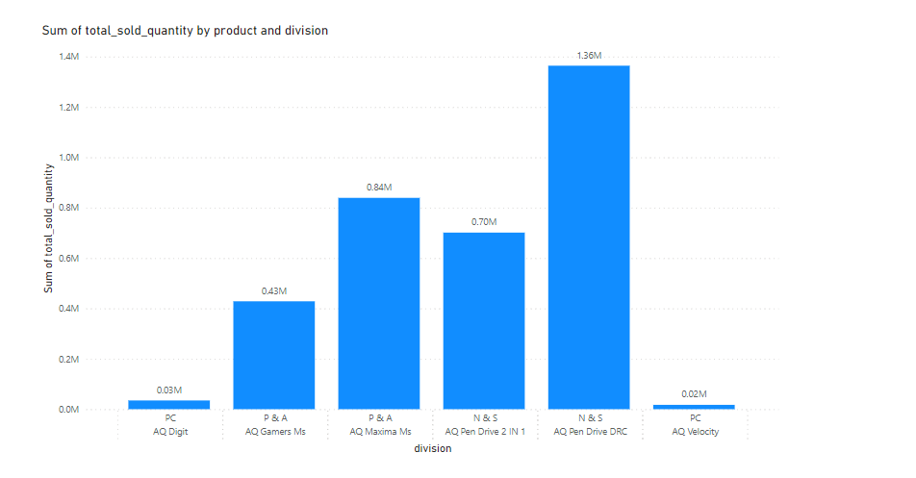
VISUALS-01
Insights
In the x-axis we have division with products and in y-axis sum of total sold quantity AQ pen drive DRC are in the first position with 1.36 M sales and Aq Maxima MS are in the second position with 0.84M AQ Velocity in PC division has low product sold with only 0.02M
Ongoing branding and marketing efforts are important to maintain success.

Slide 28
In summary, Consumer Goods Analysis helps companies understand consumer preferences, optimize supply chains, and improve marketing strategies.

Slide 29
Thank You

